Slide 1

Empower Your Sober Self
Opening Message

Slide 2
LIFERING SECULAR RECOVERY
www.lifering.org
LifeRing is an abstinence-based, anonymous organization dedicated to providing a safe meeting space where you can experience a non-judgmental recovery conversation with your peers. We do this through the lens of LifeRing's 3-S philosophy of Sobriety, Secularity, and Self-Help.

Slide 3
LifeRing's 3-S Philosophy
Sobriety: We feel that in order to remain in recovery, we must make sobriety the top priority in our lives and maintain complete abstinence from alcohol and illicit or non-medically indicated drugs.
Secularity: Out of respect for people of all beliefs and faiths, we conduct our meetings in a secular way, which means that we do not use prayer or talk about religion in the meeting.
Self-Help: We each rely on our personal efforts, the help of this group, and family and friends to maintain long term sobriety. We believe that with work and support, we can empower our “Sober Selves” and reclaim our lives from self-destructive using. Interacting with others like ourselves breaks down the hopelessness we may have felt when trying to deal with our problems in isolation.

Slide 4
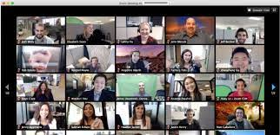
This is a Group Discussion about Recovery
This is a cross-talk meeting. Everyone can take part in the recovery discussion.
For those people who wish to do check-in, please introduce yourself by your first name and, if you wish, your last drug of choice and your recovery time. Talk about the struggles you are having maintaining sobriety and the recovery victories you have achieved during the week.
For those who do not wish to check-in, you have the option of introducing a topic related to recovery that you and others might be interested in talking about.

Slide 5
Rules of the Road
This meeting is one hour long, and we usually have an “after meeting” for those who wish it.
Visitors who are not in recovery please use Zoom Chat and let us know why you are here.
If you are under the influence of alcohol or drugs please remain quiet during this meeting. Some of us will remain after the regular meeting to talk to you.
Please refrain from offering advice. Use “I” statements rather than “you should” statements when talking to others about your recovery.
Use the Zoom Chat for recovery messages only.
A meeting verification link will be posted in Zoom chat before the end of the meeting. If you do not have access to Zoom chat, please email service@lifering.org and indicate you want the “Meeting Verification Link”.

Slide 6
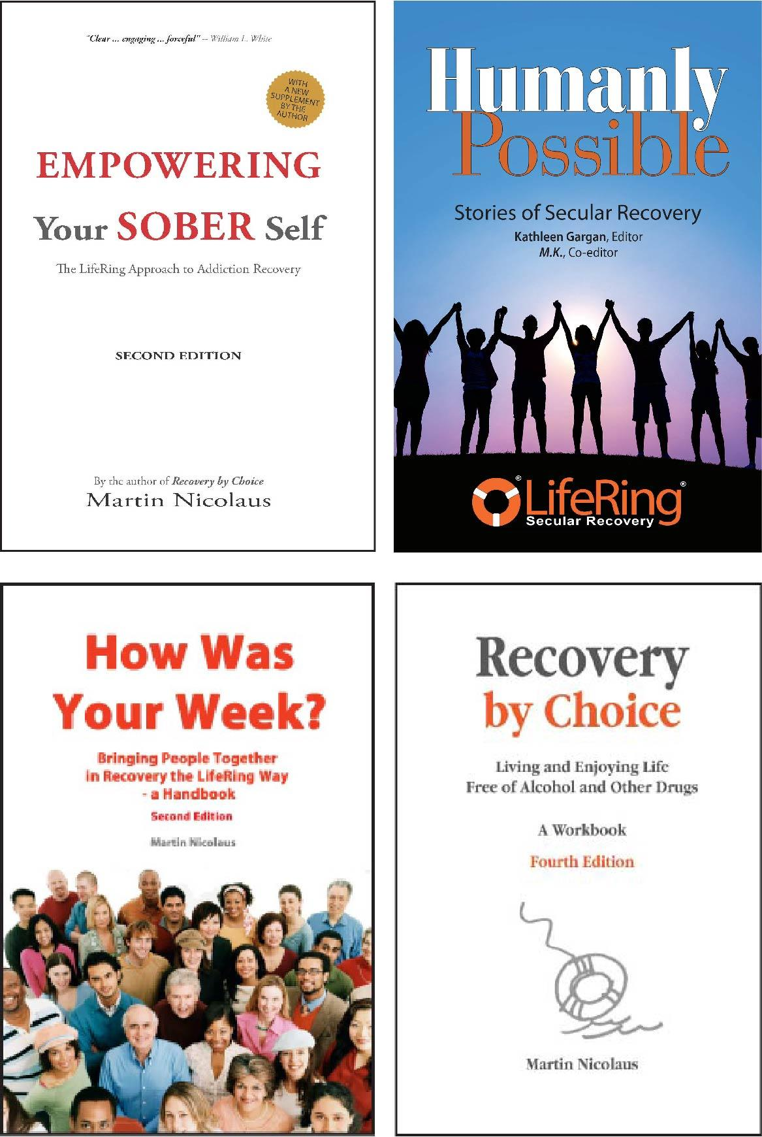
LifeRing Books
www.lifering.org/books/
Empowering Your Sober Self - $20.00, Presents an overview of the LifeRing philosophy and methodology.
Humanly Possible - $15.00, A collection of stories from people who have used a secular strategy to recover from substance addiction.
How Was Your Week - $15.00, A manual for convenors outlining the needed information and best practices for convening a LifeRing meeting.
Recovery by Choice, A Workbook - $25.00, offers a structured approach for the recovering person to build an abstinence-based “Personal Recovery Program (PRP)”.

Slide 7
Wish List
PLEASE DONATE
You can help LifeRing change a life. Together we can reach more people who are still struggling on their recovery journey. Please go to www.lifering.org and donate. Help others on the road to recovery.
WE NEED CONVENORS
If you have 6 months of continuous sobriety, are familiar with LifeRing’s 3-S philosophy of Sobriety, Secularity, and Self-Help, and understand the concept of cross-talk, you can become a convenor. Please contact the Service Center at service@lifering.org and let the team know you are interested.

Slide 8
For additional information about LifeRing go to
www.lifering.org

